Slide 1
Parallel Computing
Ekkapot Charoenwanit
Software Systems Engineering
TGGS
KMUTNB

Slide 2
Lecture 10:
Distributed-Memory Programming with MPI

Slide 3
Distributed-Memory Architectures
A HPC cluster consists of compute nodes
each node has no direct access to other nodes’ memory
each node runs a separate copy of OS
Network

Slide 4
Shared-Memory Programming Model
All processing elements P have direct access to memory M.
Data exchange is achieved through read/write operations on shared variables located in the physical global address space.
Pthreads
OpenMP
Memory M
Data
write
read
P
P
P
P

Slide 5
Distributed-Memory Programming Model
Each processing element P has its own memory module M.
Data exchange is achieved through send/received operations via a message passing mechanism over the network.
Two distinct copies of the data are at the sender and the receiver because the two processing elements do not share the same physical address space.
Data
M
Data
M
send
receive
P
P
P
P
Network

Slide 6
Distributed-Memory Programming Model
Each processing element works on a separate memory module M.
Data exchange is achieved through message passing.
Message Passing = Send/Receive operations.
No shared variables are involved because the processing elements do not share a common virtual global address space.
Synchronization is done implicitly via send/receive operations.

Slide 7
Single Program Multiple Data
Single Program Multiple Data (SPMD)
Single Binary Executable
Multiple (different parts of) Data
Each process identifies itself using a unique ID.
In an application that employs the distributed-memory programming model, each processing element has an OS process:
Each runs the same binary executable.
Each has its own virtual address space separated from those running on the other processing elements.
Process use their unique IDs to steer control flow of the individual processes.

Slide 8
Single Program Multiple Data
Compile & Link
Source Code
Executable
SPMD Launch
OS Process
OS Process
OS Process
OS Process
Data
Data
Data
Data
Data
Data
Parallel Execution
Result

Slide 9
Single Program Multiple Data
Requirements for SPMD environments
Dynamic unique identification of processes
Robust mechanisms for data exchange
Identity of sender and receiver
Amount of data
Type of data
Arrival of data
Synchronization and communication mechanisms
Point-to-point communication
Collective communication
One-sided communication
Process Launch and control mechanisms
Portability across different platforms

Slide 10
Message Passing Interface (MPI)
Message Passing Interface
The de-facto standard API for explicit message passing
Maintained by the non-profit Message Passing Interface Forum
https://www.mpi-forum.org
A number of implementations of the standard API by different vendors
MPICH, Intel MPI, Open MPI etc.
Standard Bindings include
C and Fortran
Non-standard bindings for other languages also exist
C++, Python and Java

Slide 11
Message Passing Interface (MPI)
MPI is implemented as a runtime library, not a language/compiler extension.
Initialization Mechanism:
To use MPI in a program, the programmer needs to initialize the MPI runtime.
Classical MPI (pre-MPI 4.0)
MPI_Init (with a single thread)
MPI_Init_thread (with multiple threads)
New MPI (MPI 4.0)
MPI_Session_init

Slide 12
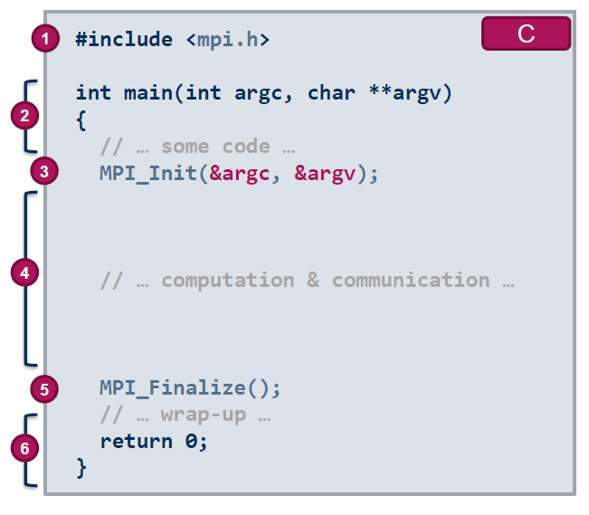
MPI: Initialization & Finalization
Initialization and Finalization:
inclusion of the header file
Pre-initialization
No MPI function calls are allowed with a few exceptions.
Initialization of the MPI environment
Parallel Computation and Communication
Finalization of the MPI environment
Post-finalization
No MPI function calls are allowed with a few exceptions.

Slide 13

MPI: Initialization (Single-Threaded)
Initialization:
MPI_Init initializes the MPI runtime environment and makes the calling process a member of MPI_COMM_WORLD.
Both arguments can be NULL.
An error code is returned (for the C binding)
MPI_Init must be called once during the program execution.

Slide 14

MPI: Finalization
Finalization:
MPI_Finalize cleans up and terminates the MPI runtime environment.
MPI_Finalize must be called once before the process terminates.
It is not recommended to have other code after the call.

Slide 15
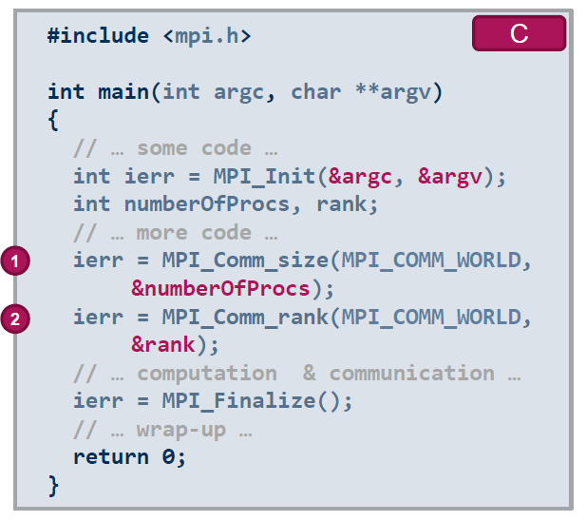
MPI: General Structure of an MPI Program
How many MPI processes are there?
The calling process can find out how many processes
there are in the MPI program with MPI_Comm_size.
Who am I?
The calling process can find out its identity or rank
with MPI_Comm_rank.
Ranks are numbered starting from zero.

Slide 16
MPI: Rank
The processes in an MPI program are initially indistinguishable.
MPI assigns each process a unique identity (rank) in a communication context (communicator).
The initial communication context is MPI_COMM_WORLD, which contains all the MPI processes within the MPI program.
?
?
?
?
?
?
?
?

Slide 17
MPI: Rank
The processes in an MPI program are initially indistinguishable.
MPI assigns each process a unique identity (rank) in a communication context (communicator).
The initial communication context is MPI_COMM_WORLD, which contains all the MPI processes within the MPI program.
Communicator
6
2
7
0
5
3
4
1

Slide 18
MPI: Rank and Communicator
Rank:
Ranks range from 0 to n-1.
where n is the number of MPI processes in the communication context (communicator).
MPI processes within an MPI program can have different ranks in different communicators.
Communicator:
A communicator is a logical context in which communication occurs.
a group of processes together with additional information.
The initial communicator MPI_COMM_WORLD is implicitly available in every MPI program.
a group of all processes the MPI runtime environment is initially launched with at startup.

Slide 19
MPI: Compiling an MPI Program
MPI is a library with C header files.
Most MPI vendors provide compiler wrappers that the programmer can conveniently use.
Note that names are not standardized.
cc
mpicc
c++
mpic++
f90
mpif90

Slide 20
MPI: Executing an MPI Program
Most implementations provide a special launcher program mpiexec.
The launcher launches nprocs instances of program with arguments arg1, arg2, arg3 etc.
The MPI standard specifies the mpiexec launcher program, but does not require it.

Slide 21
MPI: Executing an MPI Program
The launcher performs the following procedure at startup:
help MPI processes find each other and establish the MPI_COMM_WORLD communicator
redirect the standard output of all processes to the terminal
redirect the terminal input to the standard input of rank 0
forward received signals

Slide 22
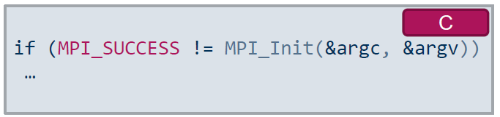
MPI: Error Handling
Error codes indicate the success of MPI calls:
Failure is indicated by an error code other than MPI_SUCCESS.
An MPI error handler is called first before the call returns.
The default error handler for non-IO calls abort the entire MPI program.
The values of error codes are implementation-dependent.
MPI_Error_string can be used decode error codes into human-reader information

Slide 23
MPI: Handles to MPI Opaque Objects
MPI objects such as communicators are referenced through handles.
Process-local values cannot be passed from one process to another.
Objects are referenced by handles are opaques.
Implementation-dependent
Blackbox to the user
Examples of handles in MPI are MPI_Comm, MPI_Datatype, MPI_Request etc.

Slide 24
MPI: Datatype Handle
MPI cannot automatically deduce the data types of supplied buffers at runtime.
The program must provide additional information on the data types.
MPI datatype handles tell the MPI runtime environment how to:
read binary values from the receive buffer
write binary values into the send buffer
correctly apply value alignments
convert values between different machine representations in heterogeneous environments

Slide 25
MPI: Datatype Handle
MPI datatypes are handles.
They cannot be used to declare variables of a specific language type.
sizeof(MPI_INT) returns the size of the datatype handle, not the size of an int in the C programming language.
Basic datatypes corresponds to native datatypes in the programming language.
MPI data type | C native data type
MPI data type | C native data type
MPI_CHAR | char
MPI_SHORT | short
MPI_INT | int
MPI_FLOAT | float
MPI_DOUBLE | double
MPI_UNSIGNED_INT | unsigned int
… | …
MPI_BYTE
No binary conversion is used for untyped data.

Slide 26
MPI: Local and Non-Local Operations
A Local operation requires
no communication with another MPI process.
Its completion depends only on the local operations.
A Non-local operation requires
some specific, semantically MPI-related procedure to be called on another MPI process.
Such an operation requires communication with another MPI process.

Slide 27
MPI: MPI Operations
MPI defines several operations that are a sequence of steps performed by the MPI runtime environment to establish and enable
data transfer
data synchronization
Four stages:
Initialization:
Resources (e.g. buffer address, arguments) are passed to the MPI runtime environment.
Starting:
The operation takes over control of the resources (e.g., buffer contents).
Completion:
The operation returns control of the resources (e.g., buffer contents).
Freeing:
The operation returns control of the remaining resources.

Slide 28
MPI: Blocking and Non-Blocking
A blocking procedure can return only when the associated operation completes locally.
Upon completion, any supplied input arguments (e.g., supplied buffer) can be safely reused or deallocated.
For example, a blocking send operation does not mean the message must have been successfully delivered to the destination before the send operation can complete. (We will see more about this)
A non-blocking procedure may return before the associated operation completes locally.
One or more additional MPI calls are required to complete the operation.
The supplied input arguments are not allowed to be reused or deallocated until the operation completes.

Slide 29
MPI: Synchronous and Asynchronous
A synchronous procedure blocks the calling process until the operation completes.
A synchronous procedure completes locally only with specific remote intervention.
In the case of a send-and-receive communication, both the sender and the receiver complete when the receiver has started to receive the message.
An asynchronous procedure may complete locally without remote intervention.
Note that synchronous/asynchronous implies blocking/non-blocking, but not vice versa.

Slide 30
References
[1] William Gropp, Ewing Lusk, and Anthony Skjellum. 2014. Using MPI: Portable Parallel Programming with the Message-Passing Interface. The MIT Press.
[2] Marc-Andre Hermanns. 2021. MPI in Small Bites. PPCES 2021.

